Slide 1

Tuesday Talk
What's Disaffiliation Got To Do With It?
Tuesday, March 28, 2022
Dr. Pam Ray, President

Slide 2
Agenda
Welcome
Introduce VIG
Historical Overview
Review UWF
  Bylaws for Staying Connected
  Guidance Sheet
  Inactive Process
Q & A

Slide 3
Historical Overview
Who We Are and What We Do
United Women in Faith connects spiritual women to act boldly for justice and transform communities. Driven by God’s love, united in sisterhood, we work boldly and fearlessly in support of women, children, and youth because we believe love in action can change the world.
Why the name change?
We learned through 2 years of surveying, including the unit survey, that the number one priority was to bring in new women and new leadership. The name United Women in Faith is part a refreshing our organization with new and improved programming to better nurture current members and make room for new women to join in whatever ways work for them. We have traditional and new ways to gather which include inside local churches, outside of local churches, and online in a sisterhood growing in faith and putting love into action on behalf of women, children, youth. This is not the first time our organization has taken a new name. In fact, over the past 150-plus years we’ve have more than 25 names, each reflecting changes in the church, the times, and the way women lived and articulated their faith and role in church and society.

Slide 4

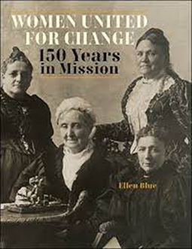
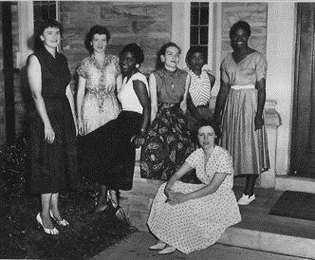

Name Change over 150 years

Slide 5
United Methodist Women is now United Women in Faith
Here’s a short video to explain:
https://www.dropbox.com/s/l24vlyeqii3pt5f/United%20Women%20in%20Faith%20Annual%20Conf%20video_Final_2%281%29.mp4?dl=0
Also, membership in the United Methodist Church has never been a requirement for membership in our organization. As a United Methodist organization, our doors are open. Our name now reflects that.
Our mission:
United Women in Faith seeks to connect and nurture women through Christian spiritual formation, leadership development, creative fellowship, and education so that they can inspire, influence, and impact local and global communities.
Our vision
Turning faith, hope, and love into action on behalf of women, children, and youth around the world.

Slide 6
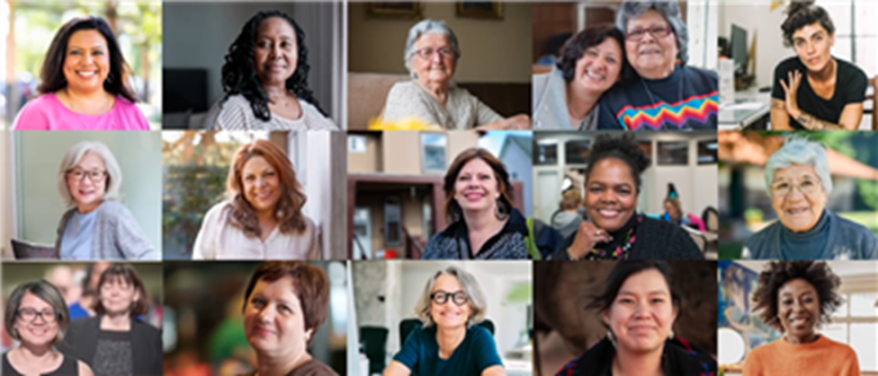
Our sisterhood starts with you
Your commitment and hard work make United Women in Faith what it is today—welcoming, inclusive, and remarkably effective. As our organization evolves, your friendly face and spiritual leadership keep us strong and moving forward. Your voice matters. The energy and talents you bring strengthen our sisterhood. Thank you for putting your love in action every day.

Slide 7


Our local “church” unit Purpose remains, for we are:
A community of women whose purpose is to know God; to experience freedom as whole persons through Jesus Christ; to develop a creative supportive fellowship and to expand concepts of mission through participation in the global ministries of the church.

Slide 8
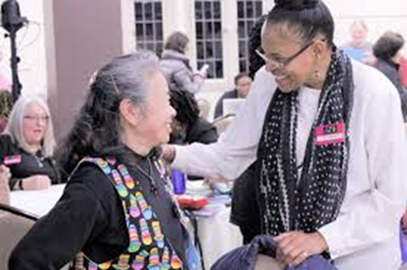
Staying Connected
What's Disaffiliation Got To Do With It?

Slide 9
United Women in Faith
By-Laws Outline Related to Staying Connected to United Women in Faith
8/4/22
The following is an outline of options for those who want to stay connected to United Women in Faith (formerly United Methodist Women), even if their local church chooses to disaffiliate from The United Methodist Church. In this case, the president of a local unit does not have to be a member of the UMC.
Local Unit of UWF: Refer to Article I, Section 4. Other Forms of Units (in the Bylaws- Local); Article III. Leadership (Bylaws-Local)
If the local church is leaving the UMC, the UWF (formerly UMW) unit CAN stay connected to UWF by:
Staying a local unit and relating to a district UWF;
Relating directly to a Conference UWF;
Joining a cluster unit;
Becoming a district unit (in districts where a District Conference is held annually, the district president must be a member of the UMC);
Becoming an ALL ACCESS online National Membership Unit.
Individual members of these disaffiliated units are eligible to be:
An All-Access online National Member;
A nominee for local unit leadership in all offices;
A nominee for District leadership (except President, who must be a member of the UMC where District Conferences are held)
A nominee for Conference leadership (except President, who must be a member of a UMC);
A voting delegate and nominee for Jurisdiction leadership - at the UWF jurisdiction level;
A nominee for Program Advisory Group, a national leadership body.
Individual members of these disaffiliated units are NOT eligible to be:
A nominee for the National Board of Directors (who must be a member of a UMC)
If a unit still chooses to disaffiliate and go inactive, please refer them to the Inactive Unit document.

Slide 10

Unit Inactive Process
What's Disaffiliation Got To Do With It?

Slide 11
Inactive Unit
United Women in Faith allows units and groups to transition to inactive status. The process is described below.
Local Presidents (not Pastor) will need to ensure that the following steps are performed for a unit to officially go inactive:
Notify Leadership
Unit president is to contact the district president and membership nurture outreach coordinator (or the conference membership nurture outreach coordinator, if needed) to report the decision and request assistance. Depending on the reason(s), the district or conference officers/coordinators may suggest a specific course of action, for example:
  Refer to the local bylaws, Article 1 Section 4b., which identifies other types of units, including how to form a cluster or charge unit. https://www.unitedmethodistwomen.org/members-leaders/2021-2024-handbook/constitution-and-bylaws
  Offer “challenges & solutions” scenarios from Leadership Development Days and develop a solution for this unit.
  Schedule a conversation with the district membership nurture outreach coordinator
2. All-Access Membership
  Prior to going inactive, the unit president will offer each individual unit member an opportunity to remain a member through joining a district or the All-Access Membership on the website. Have them visit the website at uwfaith.org or sign up at https://uwfaith.org/all-access-existing-members.
  Unit president shall send the name of the unit and all unit members to the district membership nurture outreach coordinator and to the National Office indicating who will remain a member of United Women in Faith and who no longer is interested in membership. The National Office email is membership@uwfaith.org.

Slide 12
Inactive Unit (cont’d)
3. Funds
It is required that the local treasurer will notify both the district and conference treasurers of the discontinuation and maintain communication with them throughout the process.
The local treasurer must send the district and conference treasurers a report of the unit’s giving for the past 4 years, which they will forward to the national treasurer.
Any remaining unit funds must be sent to the district treasurer. If there are designated or restricted funds, they should be sent to the national treasurer along with the original documentation describing how the funds are to be used. The district treasurer will also require copies of the final audit/review financial report.
4. Evaluate & Report
The local president will send the reason for going inactive and any pertinent information to membership@uwfaith.org.

Slide 13

Q & A

Slide 14
Contact Information
Sister Pam Ray, Ph.D.
210-724-0189
pamrayumw@aol.com

